Slide 1


Department of Computer Science and Engineering
CUSTOMER CHURN PREDICTION
USING DEEP LEARNING
Mrs. Anandhi S K
Assistant Professor
Shruthi K(200701237)
Ilakia S R(200701309)

Slide 2
Introduction
The telecom industry faces a growing challenge of customer attrition, which can lead to revenue loss and hinder business growth. Predictive analytics using machine learning and deep learning techniques offer a solution by analyzing customer data to identify potential churners. By leveraging historical customer data, including consumption patterns, billing information, and consumer behavior, telecom operators can predict potential churners and take proactive measures to retain at-risk customers, because the cost of acquiring new customers is greater than the cost of retaining the existing customer.

Slide 3
Objectives
The main objective of a customer churn prediction project is to identify customers who are likely to churn (stop using the product or service) in the near future.
Data Collection and Preprocessing
Build a Predictive Model
Identify Churn Risk Factors
Feature Engineering
Model Evaluation Metrics
Early Warning System

Slide 4
Methodology
The development of customer churn prediction system uses techniques to help businesses proactively identify and retain at-risk customers.
The system will involve the collection and preprocessing of historical customer data, including demographic information, transaction history, and customer interactions. Feature engineering and selection will be employed to extract relevant information, and a diverse set of machine learning algorithms, such as logistic regression, Random Forest and Deep Learning algorithms will be implemented to model customer churn behavior and retain customers.

Slide 5
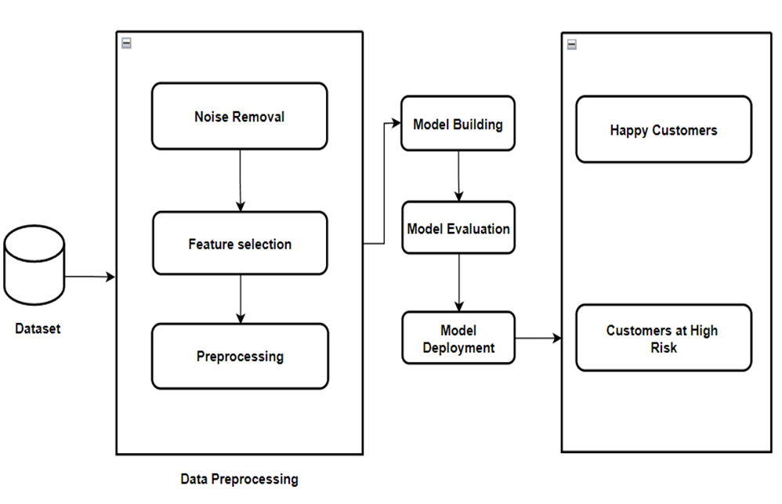
System Architecture

Slide 6
List of Modules
Data Collection and Preparation
Feature Engineering
Model Selection and Training
Model Evaluation and Deployment
Churn propensity scoring
Churn Root Cause analysis

Slide 7
Functional Description for each module
Data collection and preparation: Customer data is collected from the telecommunication industry warehouse. The data is then cleaned and preprocessed to remove any duplicate or incomplete records.
Feature engineering: This process generates new features from the available data, such as the quantity of calls made outside of peak times, the number of calls made overseas, and the overall amount of data used.
Model selection and training: The churn prediction model is trained using different models such as logistic regression, Random Forest and Deep Learning algorithms. The prepared data, which contains the newly developed characteristics, is used to train the model.

Slide 8
Functional Description for each module
Model deployment and evaluation: Evaluating churn prediction models ensures their effectiveness in identifying at-risk customers. Deployment integrates these models into production systems for proactive retention strategies.
Churn propensity scoring: Each client has a churn score that indicates how likely it is that they will leave. The trained churn prediction model is used to compute the churn score.
Churn root cause analysis: It can be discovered that a lack of new features, the cost of the service, or the caliber of the customer care are the main reasons why clients are leaving.

Slide 9
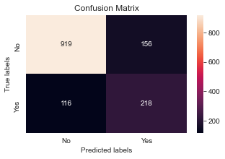
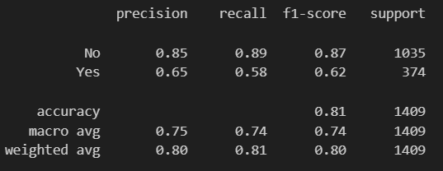
Result
Figure 2 Accuracy for churned customers
Figure 1 Customer Status

Slide 10
Conclusion
This study highlights the application of Machine learning and Deep learning techniques in predicting client retention, emphasizing their effectiveness in capturing intricate customer behaviour patterns. The telecom sector, in particular, stands to benefit significantly from this approach. By harnessing the power of Machine learning and Deep learning techniques, telecom companies can analyse extensive customer data to proactively address churn-causing factors. This predictive strategy enables the implementation of targeted retention initiatives, such as personalized offers and engagement programs, ultimately leading to reduced churn rates and heightened customer satisfaction.

Slide 11
References
[1] Agarwal, V., Taware, S., Yadav, S. A., Gangodkar, D., Rao, A. L. N., & Srivastav, V. K. (2022, October). Customer-Churn Prediction Using Machine Learning. In 2022 2nd International Conference on Technological Advancements in Computational Sciences (ICTACS) (pp. 893-899). IEEE.
[2] Agrawal, S., Das, A., Gaikwad, A., & Dhage, S. (2018, July). Customer churn prediction modelling based on behavioural patterns analysis using deep learning. In 2018 International conference on smart computing and electronic enterprise (ICSCEE) (pp. 1-6). IEEE.
[3] Ahmad, A. K., Jafar, A., & Aljoumaa, K. (2019). Customer churn prediction in telecom using machine learning in big data platform. Journal of Big Data, 6(1), 1-24.
[4] Ahmed, Ammar & Maheswari, D. (2017). A review and analysis of churn prediction methods for customer retention in telecom industries. 1-7.
[5] Amol Chole, Rushikesh Chavan, Shradha Mandan & Trupti Mate. (2023). Customers Churn Prediction using Machine Learning and Deep Learning. In 2023 Journal of Emerging Technologies and Innovative Research, ISSN-2349-5162.

Slide 12
References
[6] Anvita Gupta, Komanduri Srikar, Sreenitya Mandav. (2022) ‘Customer Churn Prediction in Banking Sector - A Hybrid Approach’, International Journal for Research in Applied Science & Engineering Technology (IJRASET), pp. 1-6.
[7] Bhatnagar, A., & Srivastava, S. (2019, December). A robust model for churn prediction using supervised machine learning. In 2019 IEEE 9th international conference on advanced computing (IACC) (pp. 45-49). IEEE.
[8] Bhuse, P., Gandhi, A., Meswani, P., Muni, R., & Katre, N. (2020, December). Machine learning based telecom-customer churn prediction. In 2020 3rd International Conference on Intelligent Sustainable Systems (ICISS) (pp. 1297-1301). IEEE.
[9] Bin, Luo & Peiji, Shao & Juan, Liu. (2007). Customer Churn Prediction Based on the Decision Tree in Personal Handyphone System Service. Proceedings - ICSSSM'07: 2007 International Conference on Service Systems and Service Management. 1 - 5.
[10] Çelik, O., & Osmanoglu, U. O. (2019). Comparing to techniques used in customer churn analysis. Journal of Multidisciplinary Developments, 4(1), 30-38.

Slide 13
References
[11] Fujo, S. W., Subramanian, S., & Khder, M. A. (2022). Customer churn prediction in telecommunication industry using deep learning. Information Sciences Letters, 11(1), 24.
[12] Gaur, A., & Dubey, R. (2018, December). Predicting customer churn prediction in telecom sector using various machine learning techniques. In 2018 International Conference on Advanced Computation and Telecommunication (ICACAT) (pp. 1-5). Ieee.
[13] Hu, J., Zhuang, Y., Yang, J., Lei, L., Huang, M., Zhu, R., & Dong, S. (2018, December). pRNN: A recurrent neural network based approach for customer churn prediction in telecommunication sector. In 2018 IEEE International Conference on Big Data (Big Data) (pp. 4081-4085). IEEE.
[14] Ismail, M. R., Awang, M. K., Rahman, M. N. A., & Makhtar, M. (2015). A multi-layer perceptron approach for customer churn prediction. International Journal of Multimedia and Ubiquitous Engineering, 10(7), 213-222.
[15] Karvana, K. G. M., Yazid, S., Syalim, A., & Mursanto, P. (2019, October). Customer churn analysis and prediction using data mining models in banking industry. In 2019 international workshop on big data and information security (IWBIS) (pp. 33-38). IEEE.

Slide 14
References
[16] Kumar, P., and Kumar, S.V. (2023). DDoS Attack Prediction System Using Machine Learning Algorithms. In: Tuba, M., Akashe, S., Joshi, A. (eds) ICT Systems and Sustainability. ICT4SD 2023. Lecture Notes in Networks and Systems, vol 765. Springer, Singapore.
[17] Kumar, P., Vinodh Kumar, S., and Priya, L. (2023). An Approach for Energy-Efficient Resource Allocation Through Early Planning of Virtual Machines to Servers in Cloud Server Farms. In: Doriya, R., Soni, B., Shukla, A., Gao, XZ. (eds) Machine Learning, Image Processing, Network Security and Data Sciences. Lecture Notes in Electrical Engineering, vol 946. Springer, Singapore.
[18] Maw, M., Haw, S. C., & Ho, C. K. (2019, November). Customer Churn Prediction in Telecommunication: An Analysis on Issues, Techniques and Future Trends. In 2019 IEEE Conference on Sustainable Utilization and Development in Engineering and Technologies (CSUDET) (pp. 148-153). IEEE.
[19] Sudharsan, R., & Ganesh, E. N. (2022). A Swish RNN based customer churn prediction for the telecom industry with a novel feature selection strategy. Connection Science, 34(1), 1855-1876.
[20] Zhang, T., Moro, S., & Ramos, R. F. (2022). A data-driven approach to improve customer churn prediction based on telecom customer segmentation. Future Internet, 14(3), 94.

Slide 15
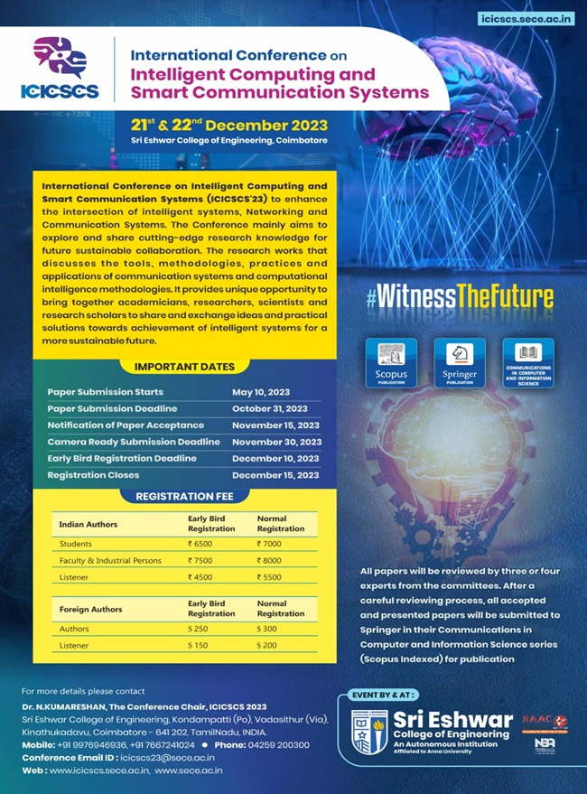
Paper Publication Status

Slide 16
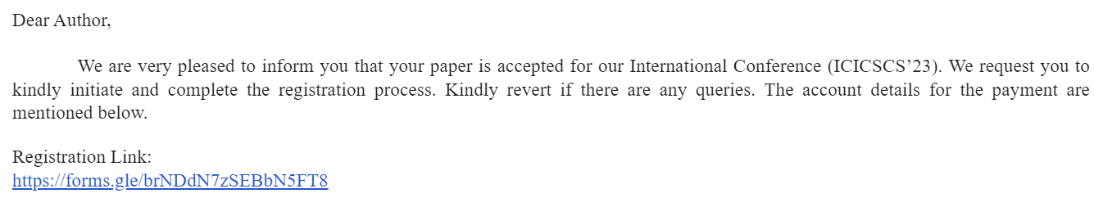
Paper Publication Status

Slide 17
Thank You

